Slide 1


bit.ly/kfp-itch

Slide 2
Keynote

Slide 3

GAME JAMS!
How we do them.
(and why you are now officially awesome)

Slide 4
WELCOME TO WARP ZONE

Slide 5
Space Rules
Code of Conduct
Located at
louisvillemakesgames.org/code-of-conduct/
Rules for the space
Venturing past the bathrooms in the hallway unless going to the street is forbidden!

Slide 6
Amenities
3 Bathrooms - 2 down the hall and 1 in the space
Refrigerator
Desks, power strips
HIGH SPEED WIFI
Warp Zone Louisville
password: GameDevLou

Slide 7
Become a member!
Member Benefits:
24/7 Keyfob access to Warp Zone
Run public events in the space
Use Warp Zone as your mailing address!
Founding Member as an honorary title if a donation of $300 is made in the first year of Warp Zone’s existence!
All for $100 a month!
More info: www.warpzonelouisville.com

Slide 8
WHAT IS A GAME JAM?
Planning , designing, and creating
a game in 48 hours!

Slide 9

What is Kentucky Fried Pixels?
Two Jams:
48 hour Kick-off Jam (You’re here!)
1-month long Development Jam

Slide 10
48 hour jam
This weekend!!!
You don’t have to work on a new game!
If you are working on a new one, come up with a cool, small idea!

Slide 11
48 hour jam
Themes
Use a theme from the list if you’re having trouble thinking of a new idea!
Diversifiers
Include these for some extra challenge.
Best usage of these diversifiers get special mention at the release of the bundle.

Slide 12
48 hour jam
For people working on old games
Work on a feature or idea you’ve been dying to add!
Flesh out an old game jam project
Try something new with an existing game.
You can still include themes and diversifies in your game

Slide 13
1 month long development jam
It doesn’t stop here! (Unless you want it to)
Continue working on your idea
You have until July 3rd to submit your game(s).
Multiple games are accepted, but try to submit your best ones!

Slide 14
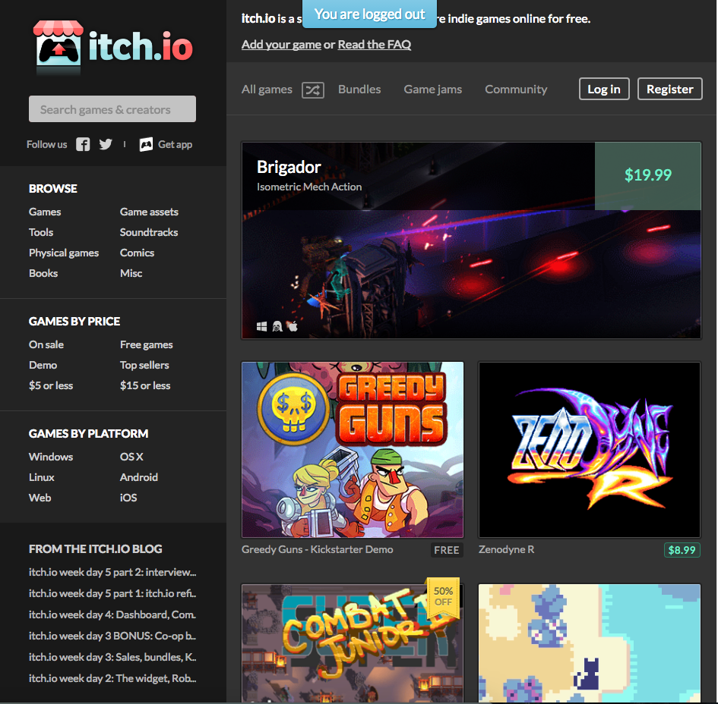
HOW TO SUBMIT YOUR GAME(s)
itch.io
Register!!!!!

Slide 15
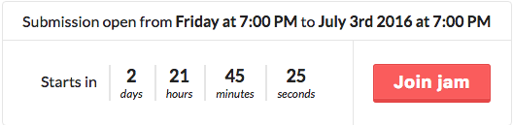
HOW TO SUBMIT YOUR GAME(s)
bit.ly/kfp-itch

Slide 16
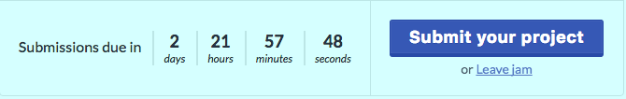
HOW TO SUBMIT YOUR GAME(s)
bit.ly/kfp-itch

Slide 17
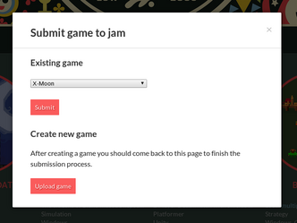
HOW TO SUBMIT YOUR GAME(s)

Slide 18
No really, make your account now.
itch.io

Slide 19
THE RULES
The only rule is you must own or have rights to all of the content of your game.
Including intellectual property!!!

Slide 20

Before the jam is over
Make sure you’re able to create builds for the following platforms:
Windows
Mac
Linux
If applicable make sure these platforms work:
Web
iOS
Mobile

Slide 21

Before the jam is over
UPLOAD YOUR FREAKIN GAME YOU CAN FIX BUGS LATER MORTY! BUUURRRPP

Slide 22
After this weekend
Keep going! You’re awesome!
You have until July 3rd to finish your game, stay motivated!
Every Sunday from 2pm to 6pm at Warp Zone will be KFP mini-jams

Slide 23
After this weekend
Your game will be sold for money along with others!
Money will be split this way:
50% goes to Louisville Makes Games, a non-profit helping to grow the game development community in Louisville
The other 50% will be split amongst all teams evenly.

Slide 24


Questions?

Slide 25


